Slide 1
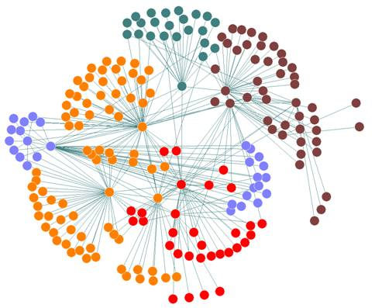
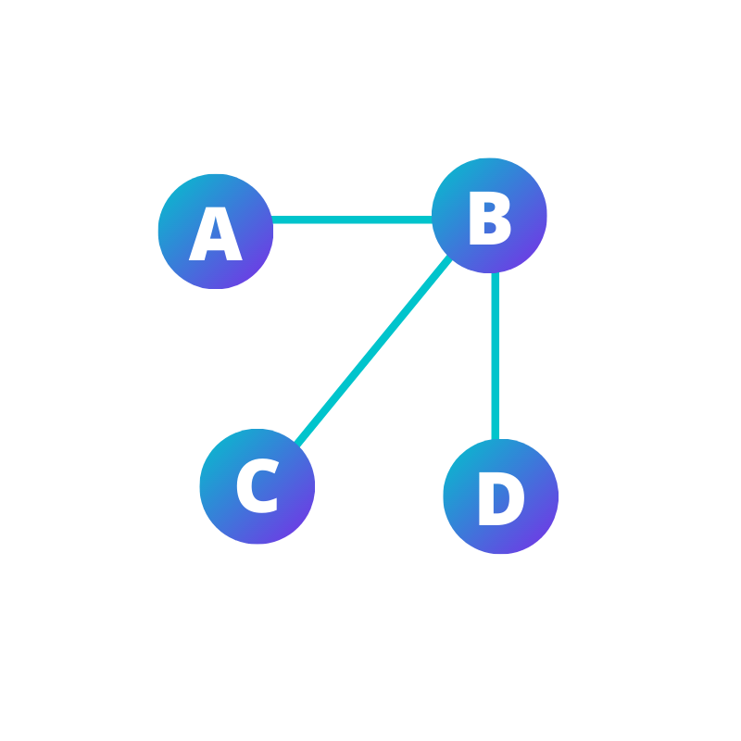
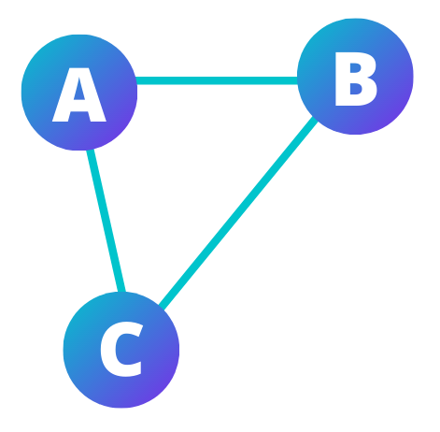
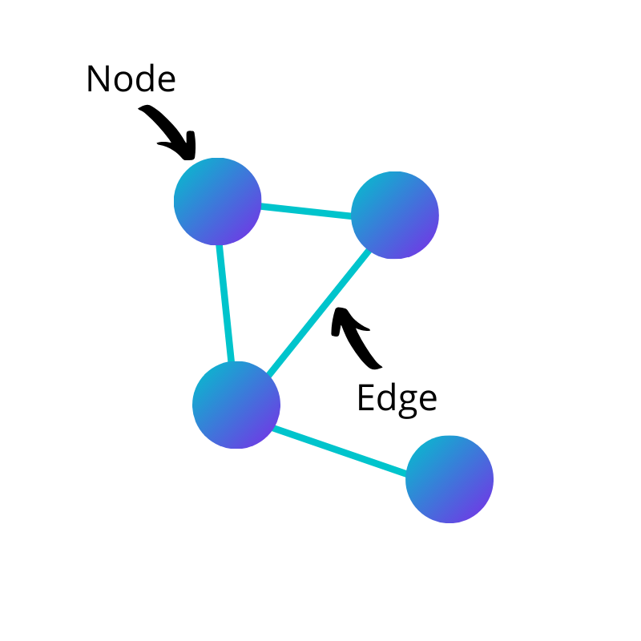
Introduction to Networks in R

Slide 2
Quick review: What is a network?
A diagram of
Nodes and Edges

Slide 3

Properties of edges
Example 1:
A twitter user tags another twitter user in a tweet, that relationship is directed.
Example 2:
A customer (starting node) pays a coffee shop (ending node) for a coffee.
Directed edges

Slide 4
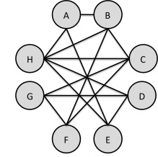
Un-directed edges
Example:
These relationships are reciprocated by both parties without a clear starting node and ending node. For example, if two people are friends on Facebook, that relationship is undirected. This is because it can be said that Person A is friends with Person B, but it can also be said that Person B is friends with Person A.

Slide 5
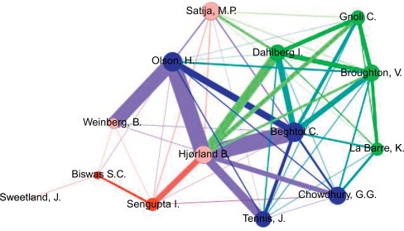
Edge Weight
Example:
An Edge’s weight is the number of times that edge appears between two nodes. For example, if Person A buys a coffee from a coffee shop 3 times, the edge connecting Person A and the coffee shop will have a weight of 3.
However, if Person B only buys coffee from the coffee shop once, the edge connecting Person B and the coffee shop will have a weight of 1.

Slide 6
Properties of nodes
Centrality is a collection of metrics used to quantify how important and influential a specific node is to the network as a whole.
Commonly used centrality measures include:
  Degree
  Closeness
  Betweeness
  Etc.

Slide 7
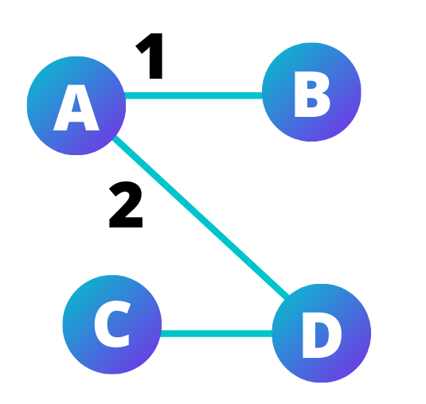
Degree
Undirected networks
The number of edges a node has in a network.
Directed networks
In-degree: income edges
Out-degree: outgoing edges
Degree: total edges

Slide 8
Closeness
How well connected a node is to every other node in the network.
OR
A node’s closeness is the average number of hops required to reach every other node in the network.

Slide 9
Network-Level Measures
These are the metrics to evaluate the entire network instead of a single node in it, such as:
Network size: number of nodes in a network
Network density: Network density is the number of edges divided by the total possible edges.
Etc.

Slide 10
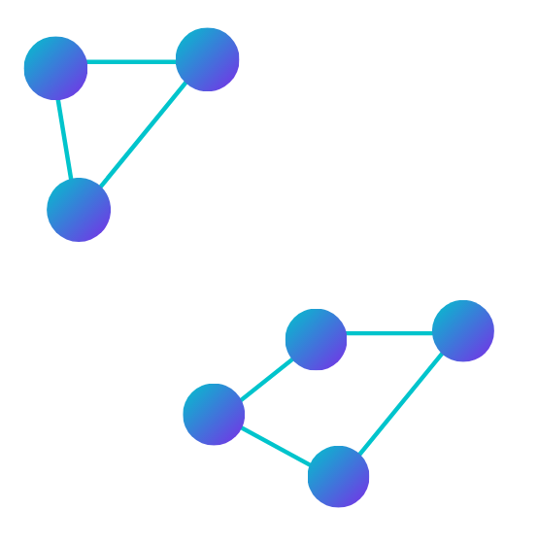
Other characteristics
Groups
Group1
Group 2

Slide 11
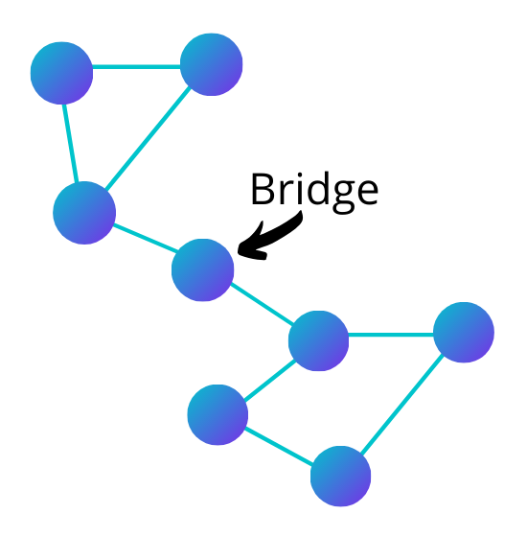
Bridges

Slide 12
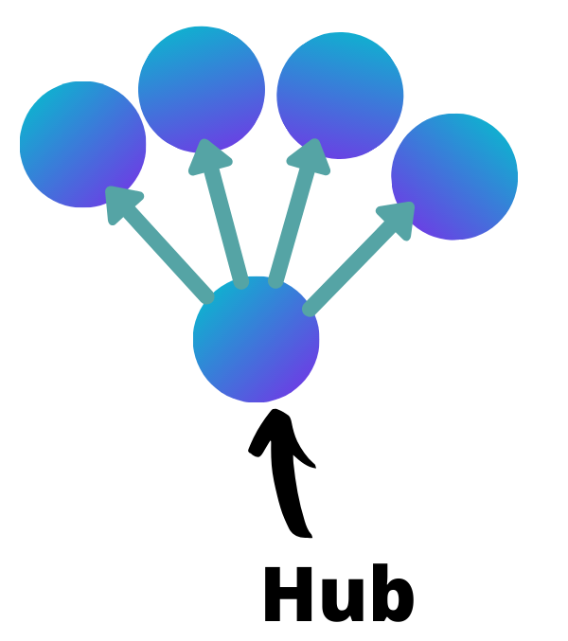
In directed networks, a hub is a node that has many outwards edges.

Slide 13
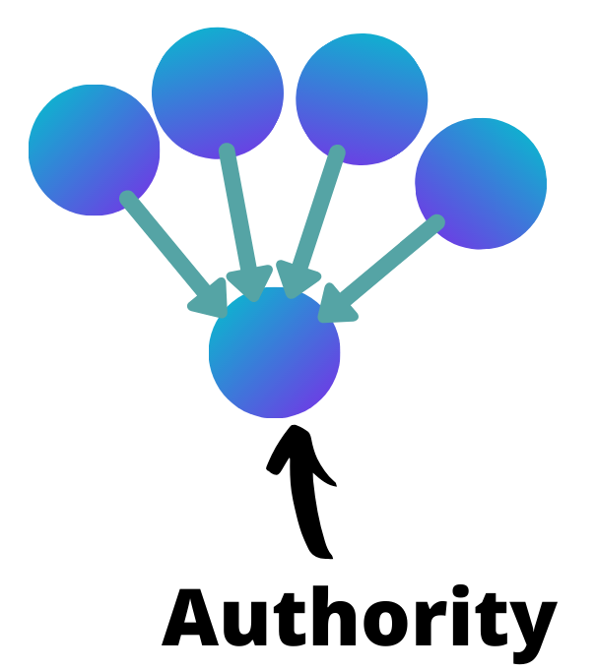
A node that has many inwards edges.

Slide 14
Summarising and visualising data using networks
Nodes:
  size, colour, icons, font, styles etc.
Edges:
  direction, weight, style
Network:
  Temporal slicing / animation / evolutionary networks
  Geospatial overlying
  Hierarchical layouts
  Clustering

Slide 15
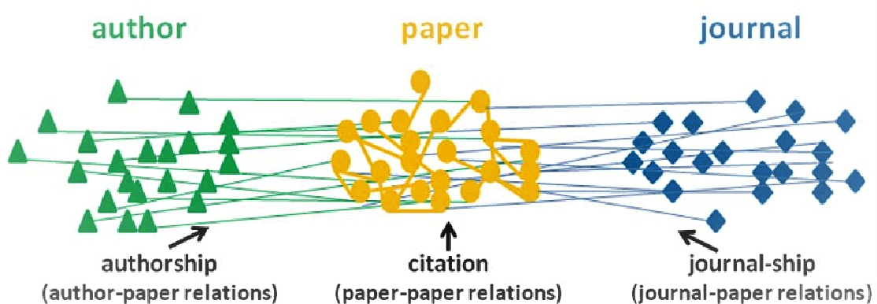
Nodes: size, colour, icons, font, styles etc.
Notes:
Source: https://towardsdatascience.com/scholarly-network-analysis-22cd352c0f86

Slide 16
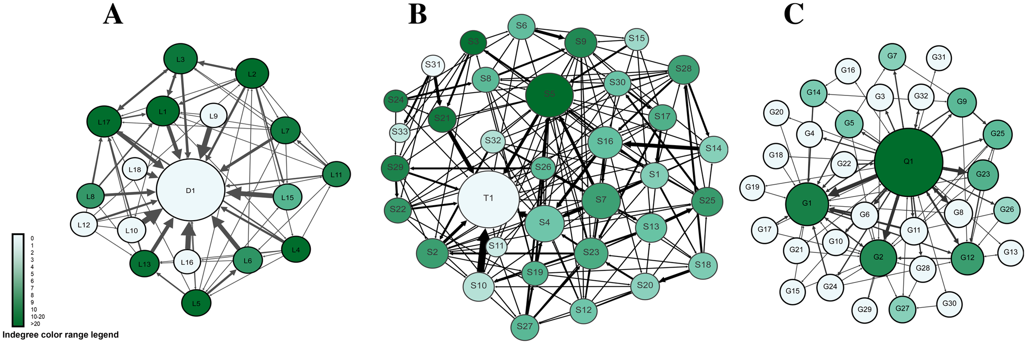
Edges: direction, weight, style
Notes:
https://journals.plos.org/plosone/article/figure?id=10.1371/journal.pone.0194777.g004

Slide 17
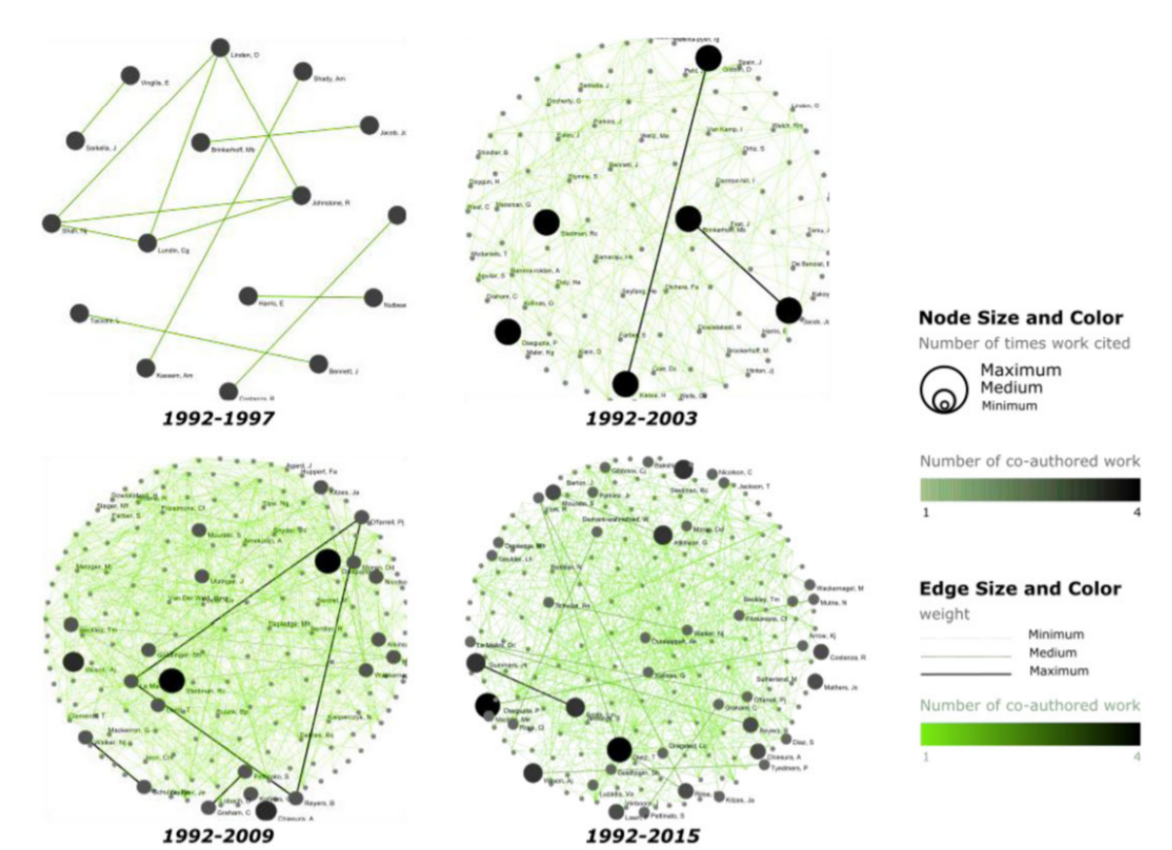
Temporal slices
Notes:
https://journals.plos.org/plosone/article/figure?id=10.1371/journal.pone.0194777.g004

Slide 18
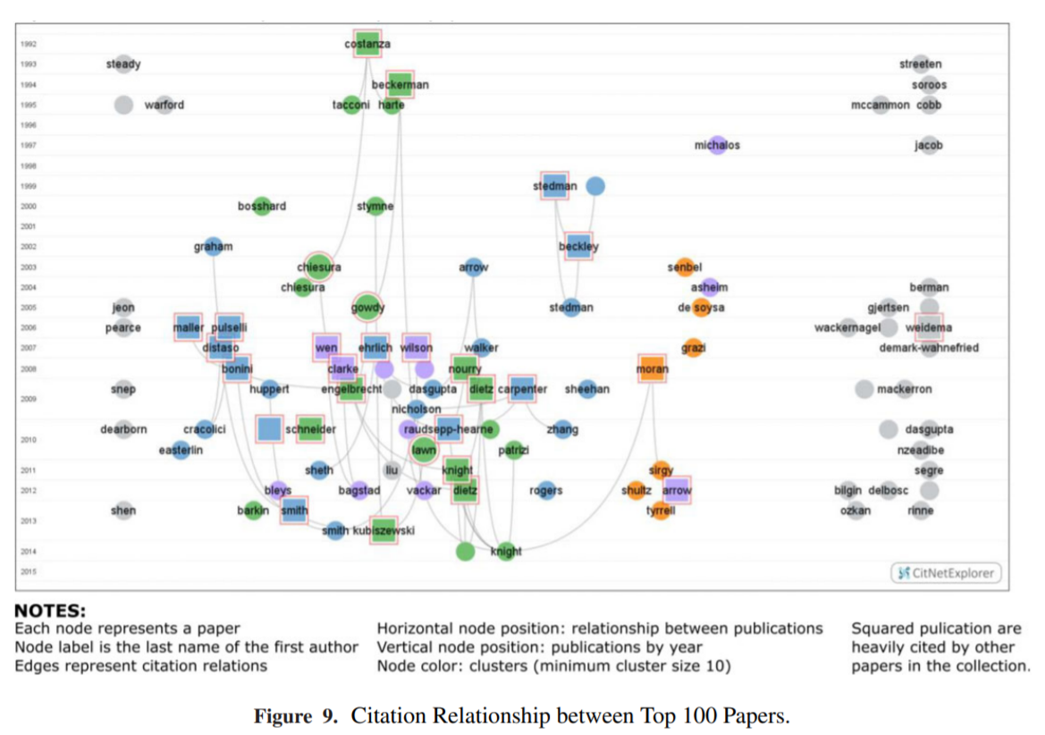
Temporal slices
Notes:
https://journals.plos.org/plosone/article/figure?id=10.1371/journal.pone.0194777.g004

Slide 19
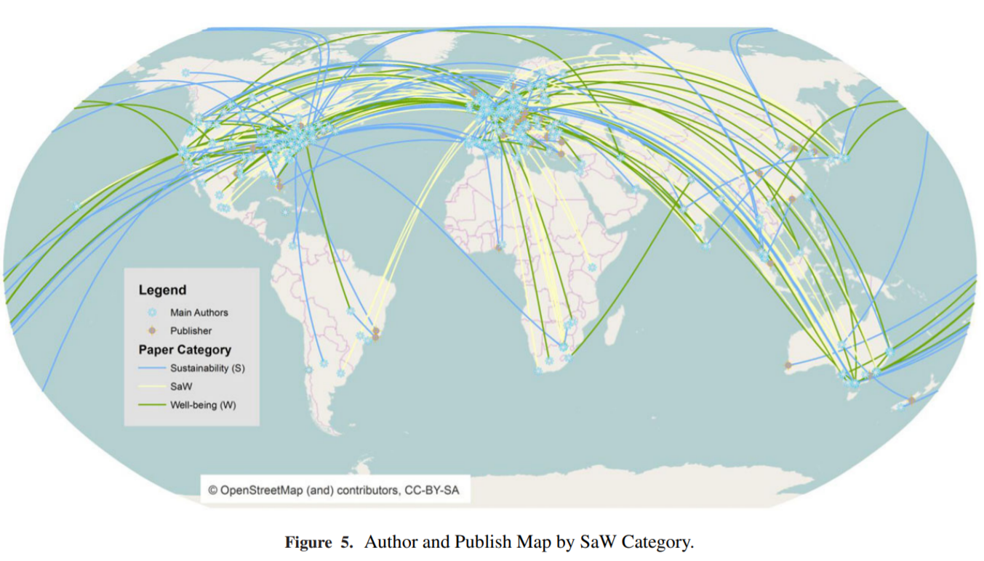
Geospatial networks
Notes:
https://journals.plos.org/plosone/article/figure?id=10.1371/journal.pone.0194777.g004

Slide 20
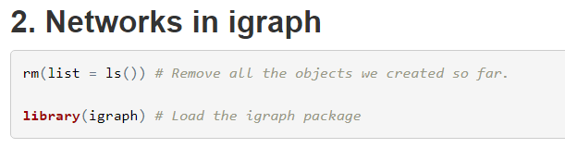
Excercise
install.packages(‘igraph’)
library(igraph)
https://kateto.net/networks-r-igraph

Slide 21
Resources
https://igraph.org/
https://kateto.net/networks-r-igraph
https://towardsdatascience.com/how-to-get-started-with-social-network-analysis-6d527685d374

